Slide 1
Fingerprint Door Lock System using Arduino Nano and Smartphone

Slide 2
TABLE OF CONTENTS
Overview: Arduino Fingerprint Door Lock
Components Required
- Solenoid Lock
Circuit Diagram: Arduino Fingerprint Door Lock
Arduino Program Code Explanation
Android App for Arduino based Fingerprint Door Lock
Testing the Fingerprint Door Lock using Arduino Project
Advantages
Disadvantages
References
Conclusion

Slide 3
INTRODUCTION
In this project, we are going to build a Fingerprint Door Lock using Arduino Nano with Bluetooth Module, Solenoid Lock, and Android SmartPhone. An Android application is designed, which scans and verifies the fingerprint and sends confirmation data to Arduino through Bluetooth serial communication. This system uses a built-in smartphone Fingerprint sensor to lock and unlock the door.
Nowadays, Electronically controlled door locks are popular. Traditional key-based mechanical door locks are slowly going out of the trend. People of today’s world need easy access to control their home appliances and add more security to your home. The IoT trend is gradually increasing, we can see different types of IoT-based smart door locks, RFID-based Master card door locks\, and Password-based security door locks, etc.

Slide 4
COMPONENTS REQUIRED
Arduino Nano
HC-05 Bluetooth Module
Solenoid Lock
Single Channel Relay Module
Breadboard
Jumper Wires
Buzzer
7805 Voltage Regulator

Slide 5
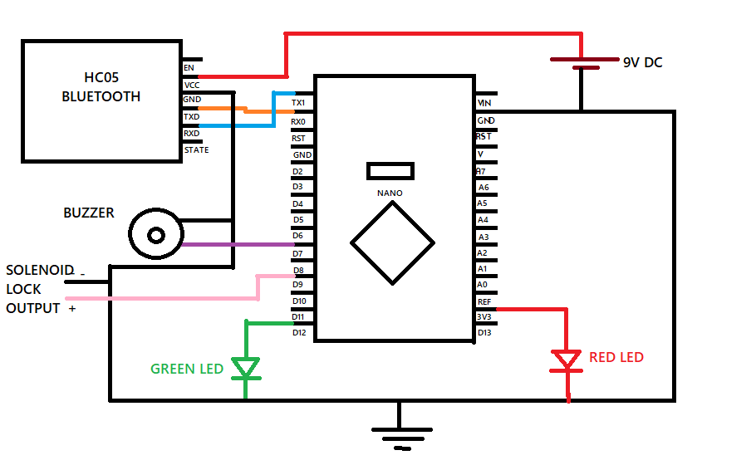
CIRCUIT DIAGRAM

Slide 6
Circuit assembly for this project is very simple. Here we are only connecting a Bluetooth Module,LEDs and a buzzer with Arduino Nano. The VCC and GND pins of the Bluetooth module are connected to Output of Voltage Regulator and Ground while Tx and Rx pins are connected to Rx and Tx of Arduino NANO respectively.
The green LED is connected to Digital pin 12 of the Nano while buzzer and output to solenoid lock are connected to digital pin 7 and 9 respectively. The GND of the Nano is connected to the ground.

Slide 7
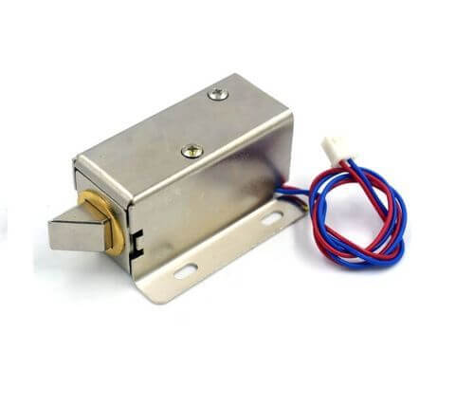
Solenoid Lock
In traditional door locks, there is a key to pull or push the latch, and we have to operate it manually. But on a solenoid lock, the latch can be operated automatically by applying some voltage. The solenoid lock contains a low-voltage solenoid that pulls the latch back to the door while an interrupt is activated (e.g. pushbutton, relay, etc.). The latch maintains its position until the interrupt is active. The operating voltage for the solenoid lock is 12V. Solenoid door locks are mainly used to automate operations in remote areas without involving any human effort.

Slide 8
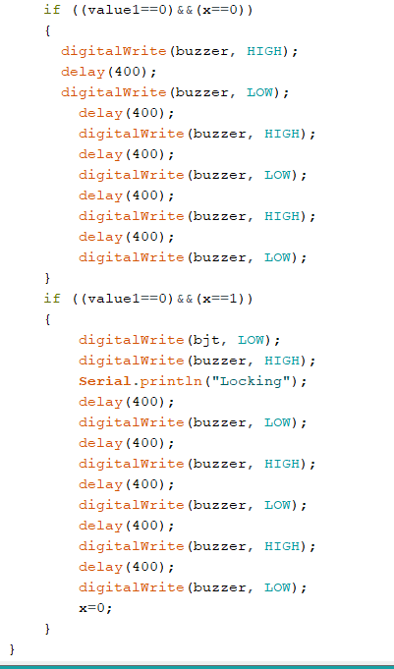
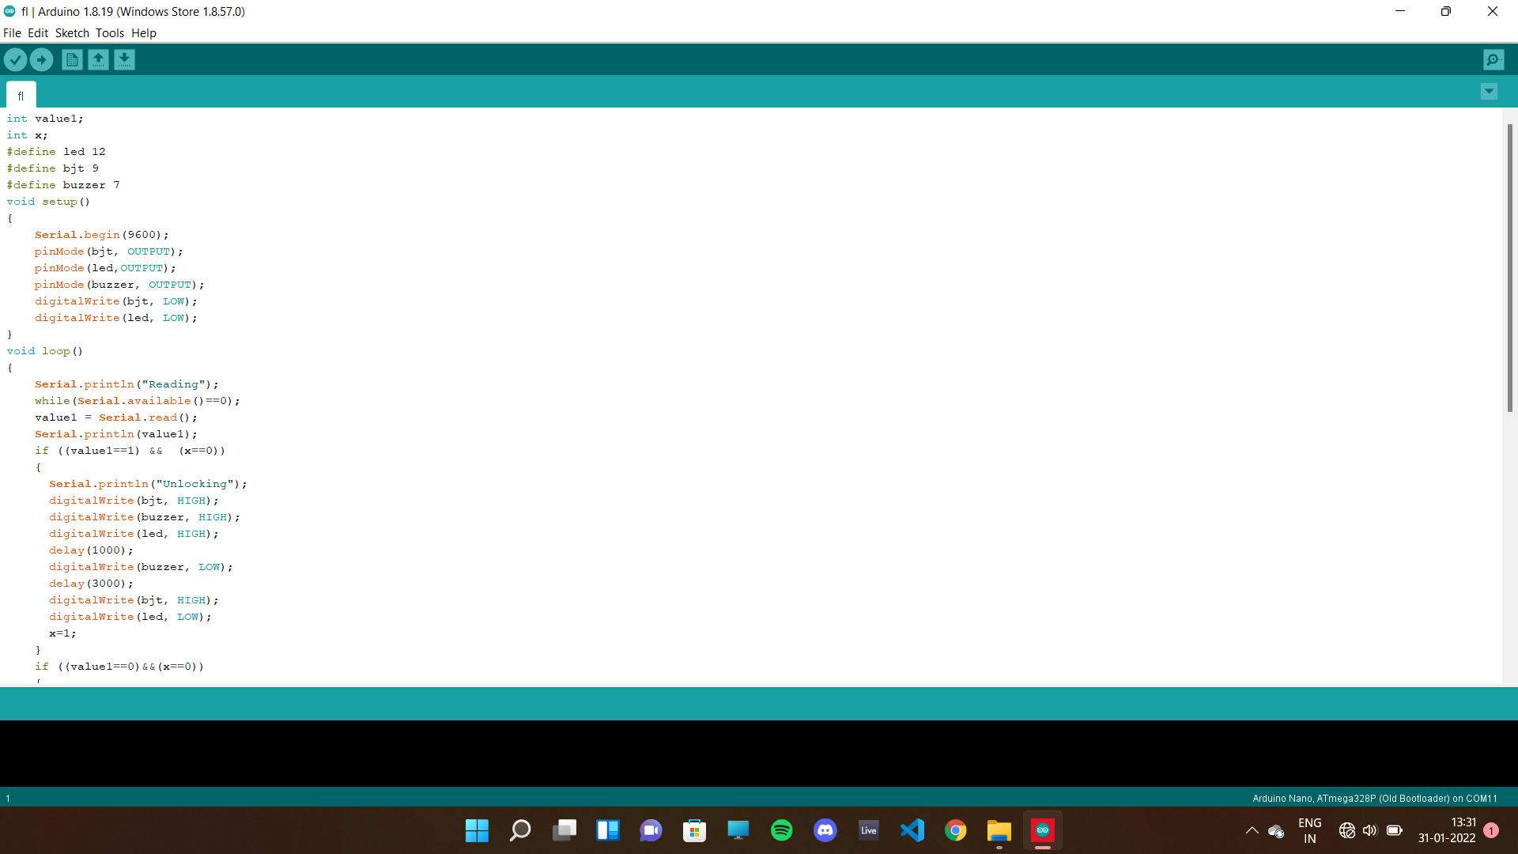
Arduino Program Code

Slide 9
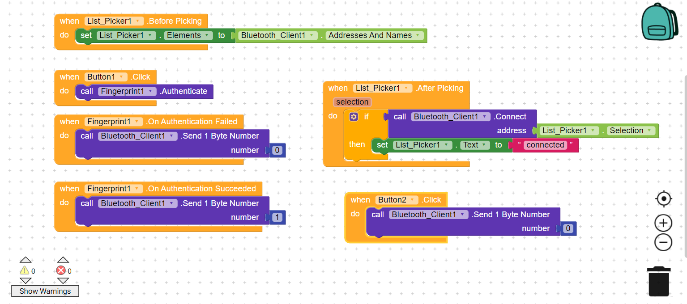
Android App for Arduino based Fingerprint Door Lock created using Kodular

Slide 10

Testing the Fingerprint Door Lock using Arduino Project

Slide 11
ADVANTAGES
Security The design of the door lock will never permit a person without your authorization to get inside the home or office. This is one of the major benefits of the fingerprint locks.
No problem of lost keys way to keep your home and business life easy is to use the fingerprint locks.
User-friendly You need not be techy to use the locks with fingerprint access.
Hard to override No one can easily hack the locks with fingerprint systems. Unauthorized access will not be granted.

Slide 12
DISADVANTAGES
Hard to install You will need a technician to set it up all for perfection.
Difficult to change You will not be able to replace your fingerprints, so it is hard to get in your office or home if somebody hacks and changes the locks.
Expensive The more advanced the locks, the more expensive it will be.
Failure in power The fingerprint needs the power to work. When the power fails, it is hard to use it. One solution for this is also to install a UPS for the machine to work which will require extra resources.

Slide 13
REFERENCES
https: //circuitdigest.com
https: //theiotprojects.com
https://www.tinkercad.com

Slide 14
CONCLUSION
Fingerprint locks are pretty awesome. Secure, affordable, non-intrusive and almost fail safe, these systems don't require you to carry a key or remember a password. You can also grant access to as many people as you want and remove their access at your pleasure.

